Slide 1

How to Use this Slide Deck
[Last Updated 08.20.2015]
What’s Included?
Instructional and exercise slides for the LabVIEW Student Ambassadors
End of lesson quiz questions
Exercises that are designated “Homework” exercises
What’s Excluded?
Sections involving hardware

Slide 3
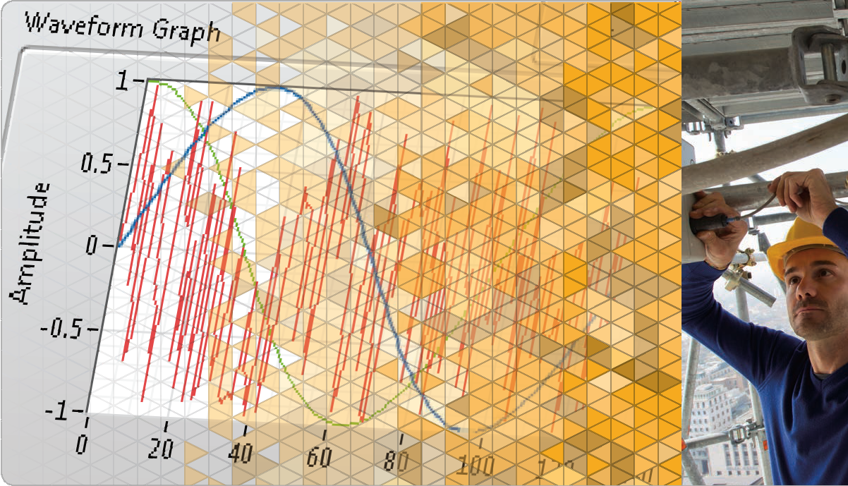
LabVIEW Core 1
Notes:
The slides from here to the first lesson slide are the standard front matter for any course. Any text in red should be replaced with text appropriate to your course.

Slide 4
Welcome to LabVIEW Core 1
Course Learning Map
Lesson 1
Troubleshooting and Debugging VIs
Lesson 4
Lesson 2
Navigating LabVIEW
Creating Your First Application
Lesson 3
Using Loops
Lesson 5
Modularity
Lesson 6
Creating and Leveraging Data Structures
Using Decision-Making Structures
Lesson 7
Lesson 8
Using Sequential and State Machine Programming
Lesson 9
Acquiring Measurements with Hardware
Accessing Files in LabVIEW
Lesson 10
Notes:
<Replace text with your lesson titles. Click each smart art, press the left expand icon, and add or remove Lessons as needed. Resize the smart art to fit the actual number of lessons.>

Slide 5
Lesson 4
Using Loops
Recognize the different components of a LabVIEW loop structure and apply a For Loop or a While Loop appropriately
Loops Review
While Loops
For Loops
Timing a VI
Data Feedback in Loops
Plotting Data

Slide 6
E. Data Feedback in Loops
Apply shift registers when appropriate and predict the correct value at different iterations of the loop.
Introduction to Shift Registers
Using Shift Registers
Creating Shift Registers

Slide 7
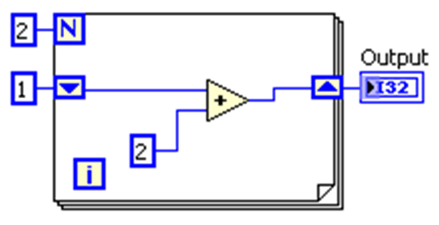
E. Data Feedback in Loops
Introduction to Shift Registers

Slide 8
Using Shift Registers
Shift Registers
Initializing Shift Registers
Default for Unwired Values
Compound Shift Registers

Slide 9
Creating Shift Registers
Create shift registers and convert existing tunnels to shift registers.

Slide 10
Exercise 4-2
Calculating Average Temperature
Use a While Loop and shift registers to average data.

Slide 11
Exercise 4-2
Calculating Average Temperature
You calculated the average of the last 5 temperature readings. How would you modify the VI to calculate the average of the last 10 temperature readings?

Slide 12
F. Plotting Data
Use data feedback in a loop to plot waveform charts.
Waveform Chart
Waveform Chart Properties

Slide 13
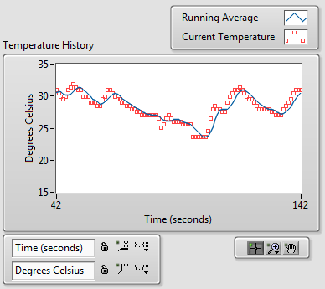
F. Plotting Data
Waveform Chart

Slide 14
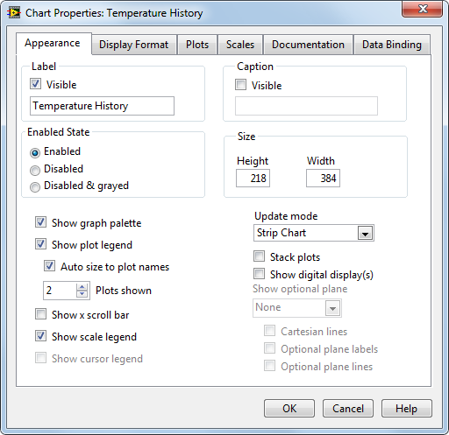
F. Plotting Data
Waveform Chart Properties

Slide 15
Exercise 4-3
Temperature Monitor VI—Plot Multiple Temperatures
Plot multiple data sets on a single waveform chart and customize the chart view.

Slide 16
Exercise 4-3
Temperature Monitor VI—Plot Multiple Temperatures
In what ways do the following tools allow the user to interact with the plot?
Plot Legend
Graph Palette
Scale Legend

Slide 17

Activity 4-2
Lesson Review
Refer to the participant guide to answer questions about what you have learned in this lesson and then discuss the answers as a group.

Slide 18
Lesson Review
1. Which structure must run at least one time?
For Loop
While Loop

Slide 19
Lesson Review
1. Which structure must run at least one time?
For Loop
While Loop

Slide 20
Lesson 5
Creating and Leveraging Data Structures
Create, manipulate and use arrays, clusters, and type definition controls for data access and analysis.
Arrays
Common Array Functions
Polymorphism
Auto-Indexing
Clusters
Type Definitions

Slide 21
A. Arrays
Identify when to use arrays and learn how to create and initialize arrays.
1D and 2D Arrays
Creating an Array Control and Constant
Initializing Arrays

Slide 22
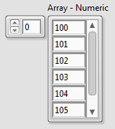
A. Arrays
Arrays
A collection of data elements of the same type.
Notes:
Arrays are lists of elements of the same data type. They are analogous to arrays in traditional languages.
Arrays can have one or more dimensions.
Arrays can have up to 2^31 elements per dimension. Actual array sizes that students can create is limited by memory.
Elements are accessed by an index. The index ranges from 0 to N-1 (N = number of elements in the array).
Arrays are zero-indexed (first element is zero) in each dimension.
A 2D array is analogous to a spreadsheet or table.
Example: If your data contains temperature readings and time stamps, one column is time values and the other column is readings.
Be careful to specify the element you really want. Example: The first element in an array is array (0), not array(1).

Slide 23
A. Arrays
1D and 2D Examples
1D array - One row of 10 elements
0 1 2 3 4 5 6 7 8 9
1.2
3.2
8.0
5.1
6.0
1.0
2.5
1.7
Index numbers
2D array - Five-row by seven-column table of 35 elements
0 1 2 3 4 5 6
0
1
2
3
4

Slide 24

A. Arrays
2D Arrays
2D arrays:
Store elements in a grid.
Require a column index and a row index to locate an element, both of which are zero-based.

Slide 25
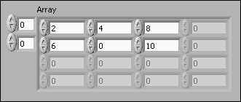
A. Arrays
Initializing Arrays
Uninitialized Array
Initialized Array

Slide 26

Viewing Arrays
First element at index 1
Second element at index 2
The elements at index 0 are not shown because element 1 is selected in the index display.
The element selected in the index display always refers to the element shown in the upper-left corner of the element display.

Slide 27
B. Common Array Functions
Create and manipulate arrays using built-in array functions.

Slide 28
Common Array Functions
Use LabVIEW’s built-in array functions to create and manipulate arrays.

Slide 29
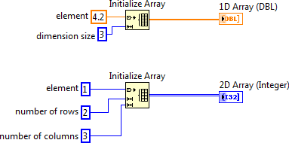

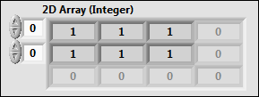
B. Common Array Functions
Initialize Array
Notes:
The Initialize Array function creates an n-dimensional array in which every element is initialized to the value of element.
Initialize array is a resizable node. Use the Positioning tool to resize the function and increase the number of dimensions (element, row, column, page, and so on) of the output array. You must have one dimension size input terminal for each dimension in the array.

Slide 30
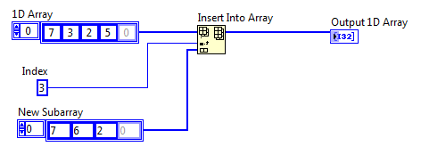
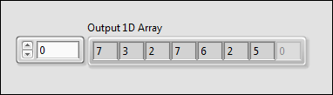
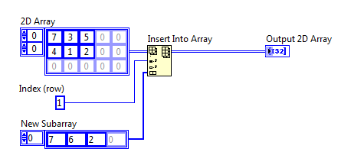
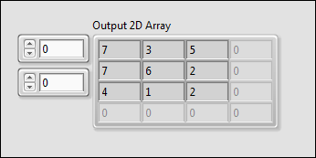
B. Common Array Functions
Insert Into Array

Slide 31
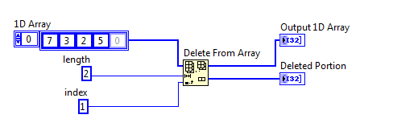
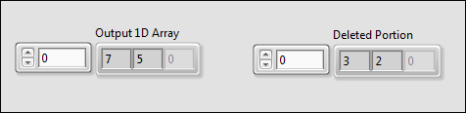
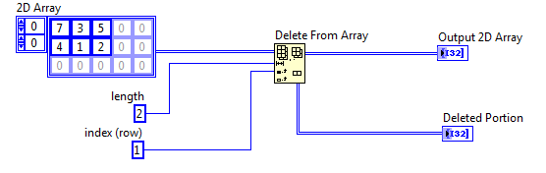
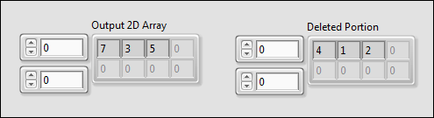
B. Common Array Functions
Delete From Array

Slide 32
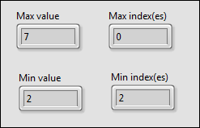
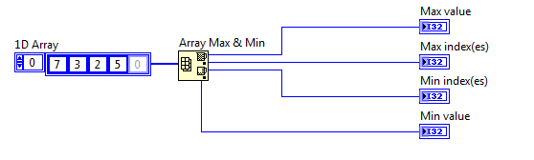
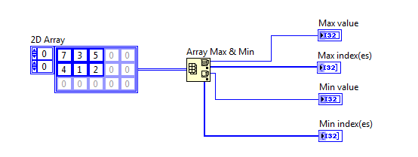
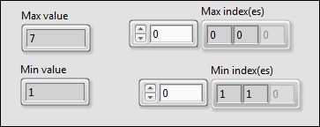
B. Common Array Functions
Array Max & Min

Slide 33
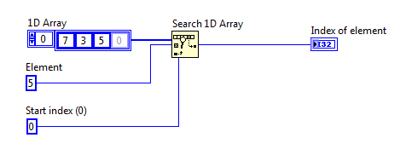

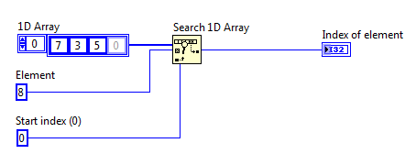

B. Common Array Functions
Search 1D Array

Slide 34
Activity 5-1
Using Array Functions
Complete the highlighted portion in each VI.

Slide 35
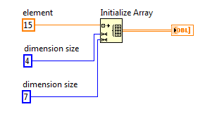
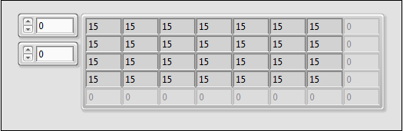
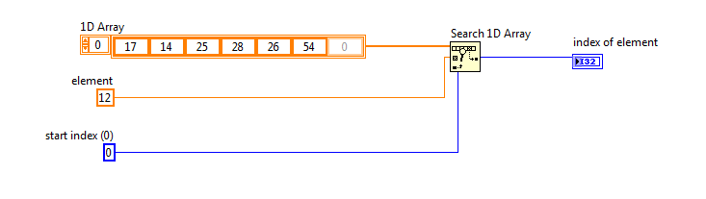

B. Common Array Functions
Activity 5-1 Answers

Slide 36
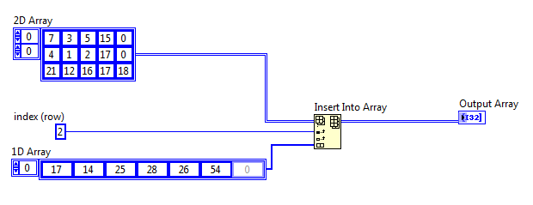
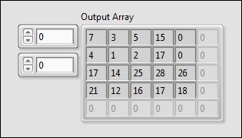
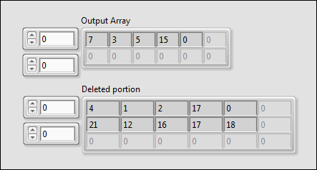
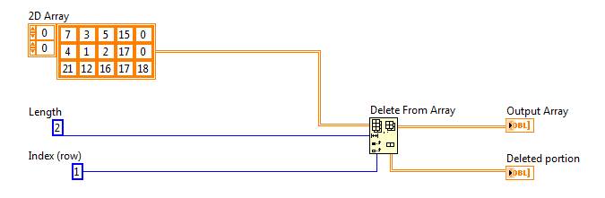
B. Common Array Functions
Activity 5-1 Answers

Slide 37
C. Polymorphism
Understand the ability of various VIs to accept input data of different data types.

Slide 38

C. Polymorphism
Polymorphism
Polymorphism—The ability of VIs and functions to automatically adapt to accept input data of different data types.
Functions are polymorphic to varying degrees:
None, some, or all of their inputs can be polymorphic.
Some accept numeric or Boolean values.
Some accept numeric or strings.
Some accept scalars, numeric arrays, or clusters of numerics.
Notes:
Functions are polymorphic to varying degrees—none, some, or all of their inputs can be polymorphic. Some function inputs accept numeric values or Boolean values. Some accept numeric values or strings. Some accept not only scalar numeric values but also arrays of numeric values, clusters of numeric values, arrays of clusters of numeric values, and so on. Some accept only one-dimensional arrays although the array elements can be of any type. Some functions accept all types of data, including complex numeric values.

Slide 39
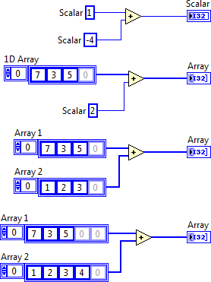




C. Polymorphism
Arithmetic Functions Are Polymorphic
Combination
Result
Notes:
LabVIEW arithmetic functions are polymorphic.
Inputs to arithmetic functions can be of different data types.
The function automatically performs the appropriate operation on unlike data types.
LabVIEW arithmetic functions greatly simplify array arithmetic.
Examples of polymorphism on this slide:
Scalar+Scalar: Scalar addition.
Scalar+Array: The scalar is added to each element of array.
Array+Array: Each element of one array is added to the corresponding element of other array.
In case students ask, polymorphism does not perform matrix arithmetic when inputs are 2D arrays. (For example, multiplying two 2D array inputs with the Multiply function performs an element by element multiplication, not matrix multiplication).
LabVIEW ships with other examples of arithmetic functions showing polymorphic combinations of inputs.

Slide 40
D. Auto-Indexing
Use auto-indexed inputs and outputs to create graphs and arrays.
Use in For Loops and While Loops
Waveform Graphs
Auto-Indexing with a Conditional Terminal
Creating 2D Arrays
Auto-Indexing Input to a Loop

Slide 41


D. Auto-Indexing
Auto-Indexing
Auto-Indexing Enabled
Auto-Indexing Disabled
Wire becomes thicker
Wire remains the same size
1D Array
Only one value (last iteration) is passed out of the loop.
0 1 2 3 4 5
Notes:
For Loops and While Loops can index and accumulate arrays at their boundaries. This is known as auto-indexing.
The indexing point on the boundary is called a tunnel.
The For Loop default is auto-indexing enabled.
The While Loop default is auto-indexing disabled. Only one value (the last iteration) is passed out of the While Loop by default.
Examples:
Enable auto-indexing to collect values within the loop and build the array. All values are placed in the array upon exiting the loop.
Disable auto-indexing if you are interested only in the final value.

Slide 42
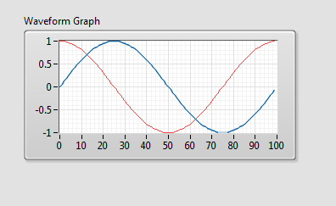
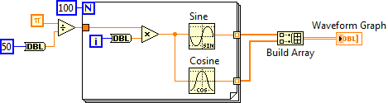
D. Auto-Indexing
Waveform Graphs

Slide 43
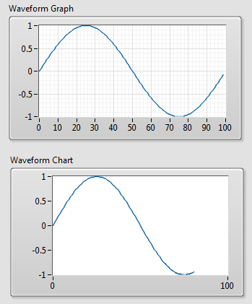
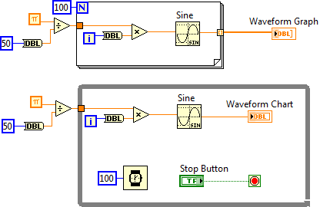
D. Auto-Indexing
Charts vs. Graphs—Single-Plot

Slide 44
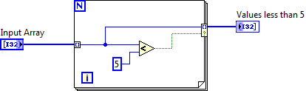

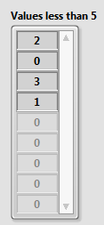
D. Auto-Indexing
Auto-Indexing with a Conditional Tunnel
Right-click on a tunnel and select Tunnel Mode»Conditional.
Notes:
You can determine what values LabVIEW writes to the loop output tunnel based on a condition you specify by right-clicking the loop output tunnel and selecting Tunnel Mode»Conditional from the shortcut menu.
Because of the conditional tunnel, the Values less than 5 array contains only the elements 2, 0, 3, and 1 after this loop completes all iterations.

Slide 45
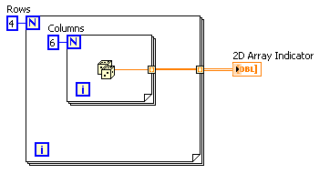
D. Auto-Indexing
Creating Two-Dimensional Arrays
Inner loop creates column elements.
Outer loop stacks column elements into rows.
2D Array
1D Array
0 1 2 3 4 5
Notes:
You can use two nested For Loops to create a 2D array. Auto-indexing must be enabled for both loops.
Explain the different line thicknesses in the wire connecting the Random Number function to the 2D Array Indicator.
Demonstrate on your computer:
How to change indexing and line thickness.
When you see Enable indexing in the shortcut menu it means that indexing is currently disabled. The menu choice is the opposite of the current indexing mode. Students get confused about this feature.

Slide 46
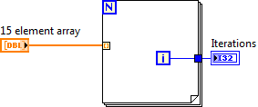
D. Auto-Indexing
Auto-Indexing Input
Use an auto-indexing input array to perform calculations on each element in an array.
Wire an array to an auto-indexing tunnel on a For Loop.
You do not need to wire the count (N) terminal.
Notes:
If you enable auto-indexing on an array wired to a For Loop input terminal, LabVIEW sets the count terminal to the array size so you do not need to wire the count terminal. Normally, if the count terminal of the For Loop is not wired, the Run arrow is broken.
In this slide, the For Loop executes a number of times equal to the number of elements in the array.
Use auto-indexing on input arrays for calculations to be performed on each element of array.
To pass the entire array into a loop, disable auto-indexing.

Slide 47
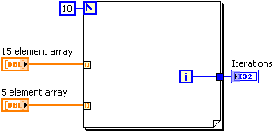

D. Auto-Indexing
Auto-Indexing Input─Different Array Sizes
Notes:
LabVIEW does not exceed an array size. This helps to protect against programming errors.
If you wire a 10-element array and a 5-element array to a For loop, the loop iterates five times.
Note: Although the For loop iterates 5 times, the number of iterations is zero-based. Therefore, the final value of the Iterations indicator is 4.

Slide 48
Exercise 5-1
Manipulating Arrays
Manipulate arrays using various LabVIEW functions.

Slide 49
Exercise 5-1
Manipulating Arrays
In the All Data Channel case, how can you verify that the two approaches yield the same results?
Notes:
In the All Data Channel case, how can we verify that the two approaches yield the same results?
You can use the comparison and Boolean functions to compare if the All Data Channel array is the same.
Comparison functions are also polymorphic. Use the Equal? function followed by the And Array Elements function.
Typically, you can’t perform a direct comparison on double-precision values. You would need to compare the values within some acceptable range. However, in this case, the polymorphic Add operation should be an exact equivalent to the Add function in an auto-indexed For loop.

